Slide 1
Detection of Plastic and Solid Waste in Oceans
By: Varad Rane
123B1F117

Slide 2
AIM & MOTIVATION
Aim
Motivation
The primary aim of this project is to address the critical need for an accurate and automatic system for identifying macroplastic waste in oceans.
This research seeks to create a more viable and scalable solution.
This approach is designed to overcome the challenges and high costs associated with traditional, manual monitoring methods
The project is driven by the urgent need to address plastic pollution, a major environmental problem that harms marine ecosystems, biodiversity and the visual appeal of oceans.
The work is further motivated by its alignment with the UN's Sustainable Development Goals, specifically SDG 14 (Life Below Water) and SDG 13 (Climate Action).

Slide 3
OBJECTIVES
To investigate how a preprocessing pipeline, consisting of CLAHE for contrast enhancement and white balancing for color correction, can improve the detection accuracy of a YOLO-based model on challenging underwater images.
To determine if enhancing key visual features and correcting color casts in the training data can help the YOLO model overcome common environmental distortions, leading to more robust object identification.
To quantify the performance lift provided by this preprocessing pipeline by comparing the YOLO model's metrics (mAP, precision, and recall) against a baseline model trained on the original, unprocessed images.

Slide 4
LITERATURE REVIEW
Sr. No | Name of the Study | Features | Methodology | Research Gaps Present
1 | Detection of marine floating plastic using Sentinel-2 imagery and machine learning models [1] | This study was successful in detecting plastic across Greece, Cyprus, Italy, and Lebanon. It noted different spectral responses, plastic bottles reflecting high Near Infrared (NIR) reflectance, and achieved ~99% model accuracy for certain sites. The Floating Debris Index (FDI) was noted to be the most important variable. | The methodology used data from Sentinel satellites and Support Vector Machines (SVMs) and Random Forest (RF) classification models. Models were trained with in situ plastic location data and remote sensing bands and indices (FDI, NDVI, PI, kNDVI). The images were atmospherically corrected using ACOLITE and C2RCC processors. | There is a need for high-quality training data and a comprehensive spectral library. A requirement to mitigate false alarms from phenomena like sea plume was noted. A broader assessment of advanced deep learning (DL) algorithms (e.g., DeepLab, YOLO) is needed.
2 | High-precision Density Mapping of Marine Debris and Floating Plastics via Satellite Imagery [2] | The study developed MAP-Mapper models with high precision (up to 95%) and introduced the Marine Debris Mapping (MDM) index to quantify density. It demonstrated the ability to detect plastics at a sub-pixel scale and mapped highly polluted regions in the Gulf of Honduras, Manila, and Mumbai. | The work combined Sentinel-2 data with U-net-based ML models, using the MARIDA and PLP datasets for training and validation. An automated data pipeline (MAP-Mapper) was developed, and atmospheric correction was performed with ACOLITE. Only four Sentinel-2 bands were used to improve efficiency. | Future work should expand the MARIDA dataset. A more rigorous validation of density mapping using ground truth data is required. Misclassifications of small boats, waves, and sea foam need to be addressed, and the use of minimal-supervision learning approaches is promoted.

Slide 5
LITERATURE REVIEW
3 | Deep learning for detecting macroplastic litter in water bodies: A review [3] | This is a systematic review of 34 DL-based studies. It identified key gaps, including a lack of model generalisation and the absence of mass flux quantification. Most studies focus on marine environments, neglecting rivers and lakes. Object detection is the most common computer vision task. | A systematic review methodology was used to analyse 34 papers from "Scopus" and "Web of Science" databases up to 2021. Papers were categorised by water body, dataset details, computer vision task, and performance metrics. | A primary need exists for DL models with robust generalisation across different conditions. There is a lack of methods for quantifying macroplastic mass fluxes and hotspots. Insufficient research on riverine pollution and inconsistent reporting of metrics across studies were also identified as gaps.
4 | Litter Detection with Deep Learning: A Comparative Study [4] | This paper provided a comparison of existing DL object detection models and a new dataset, "PlastOPol". The best accuracy from the existing models was YOLO-v5x, but the best potential for mobile devices was YOLO-v5s. All the object detection methods reported difficulty in detecting low sizes of litter and cluttered or complex backgrounds. | The study considered models based on CNNs such as the Faster R-CNN, Mask R-CNN, EfficientDet, RetinaNet, and YOLO-v5. Performance was evaluated by effectiveness (AP50) and efficiency (model size, FPS) when evaluated on the PlastOPol and TACO datasets with 5-fold cross-validation. | Future work should enhance detection using fusion strategies and continue optimising tiny neural networks for constrained devices. There is a need to improve datasets with smart data augmentation and add multiclass annotations to the PlastOPol dataset.
5 | Review of Methods for Automatic Plastic Detection in Water Areas Using Satellite Images and Machine Learning [5] | This comprehensive review highlights Sentinel-2 as the primary satellite for plastic detection. It notes FDI and PI as key spectral indices and finds that supervised algorithms (SVM, RF, XGBoost) are generally more efficient. | Information from over 50 studies was synthesised. The review discussed data acquisition (satellites, UAVs), image processing, spectral indices, and a wide range of ML/DL algorithms. | There is a demand to collect global plastic pollution research data where AI can be trained, this would also facilitate the creation of global database of types of plastic litter The paper indicates that it would be worth exploring other satellites for further ocean coverage and should also consider the opportunity for synthetic aperture radar (SAR) imagery.
6

Slide 6
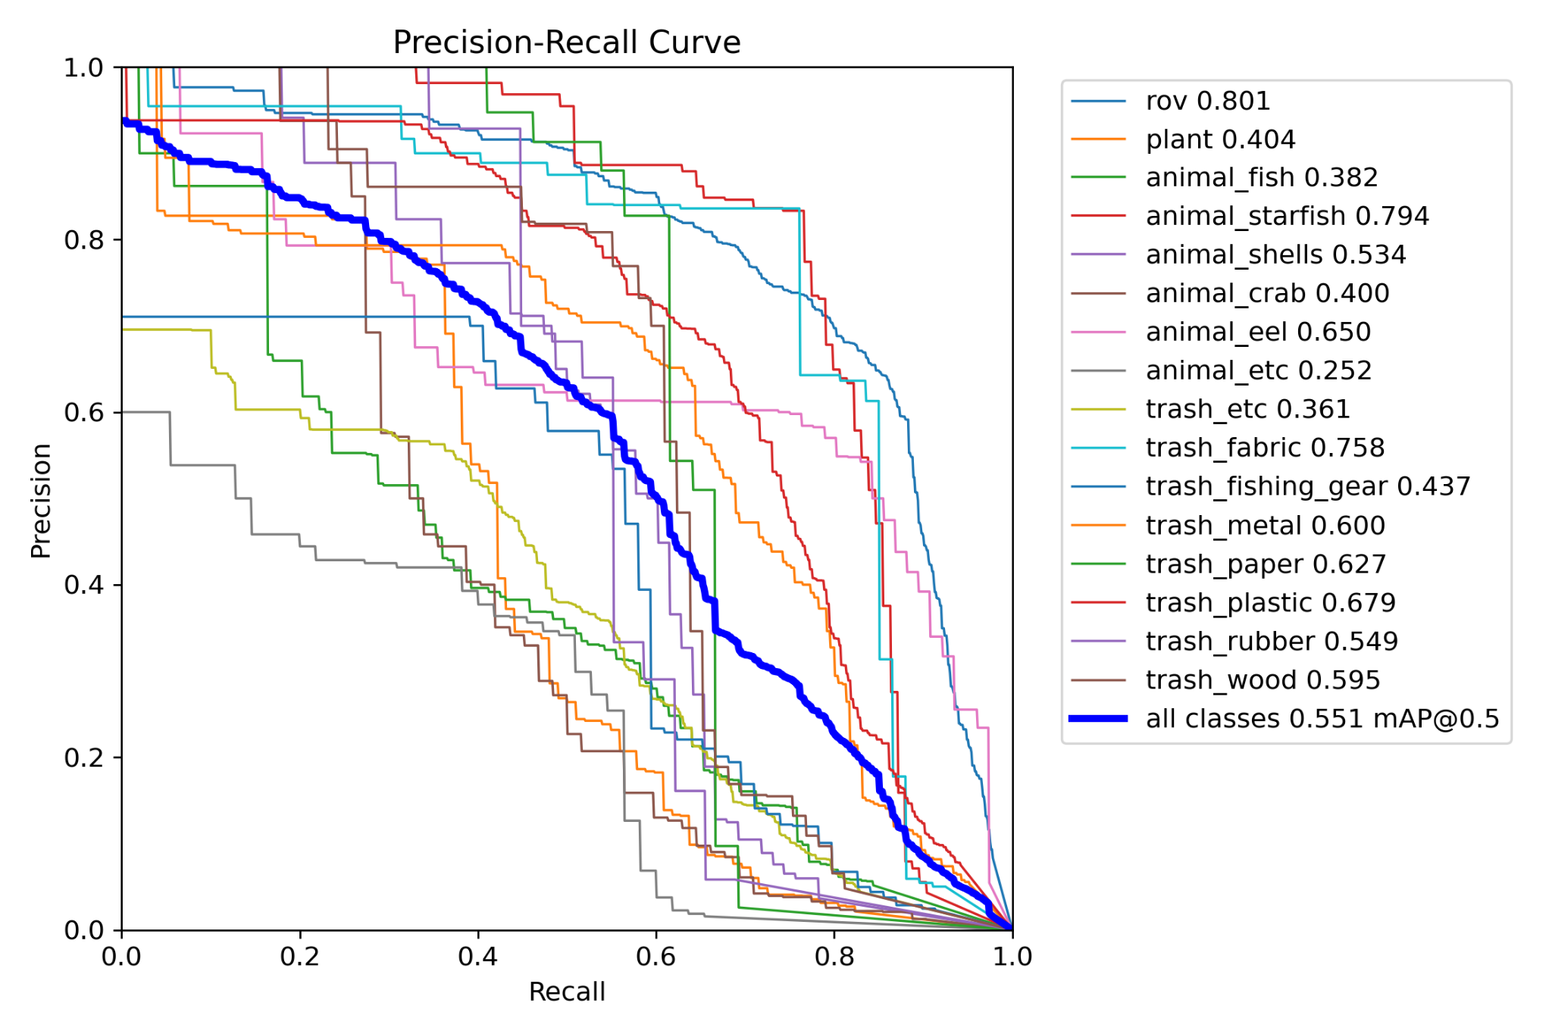
Methodology
without preprocessing original
mAP50-95 Mask mAP50-95 Precision (Box) Recall (Box)
0.36287 0.29554 0.61913 0.54515
11

Slide 7
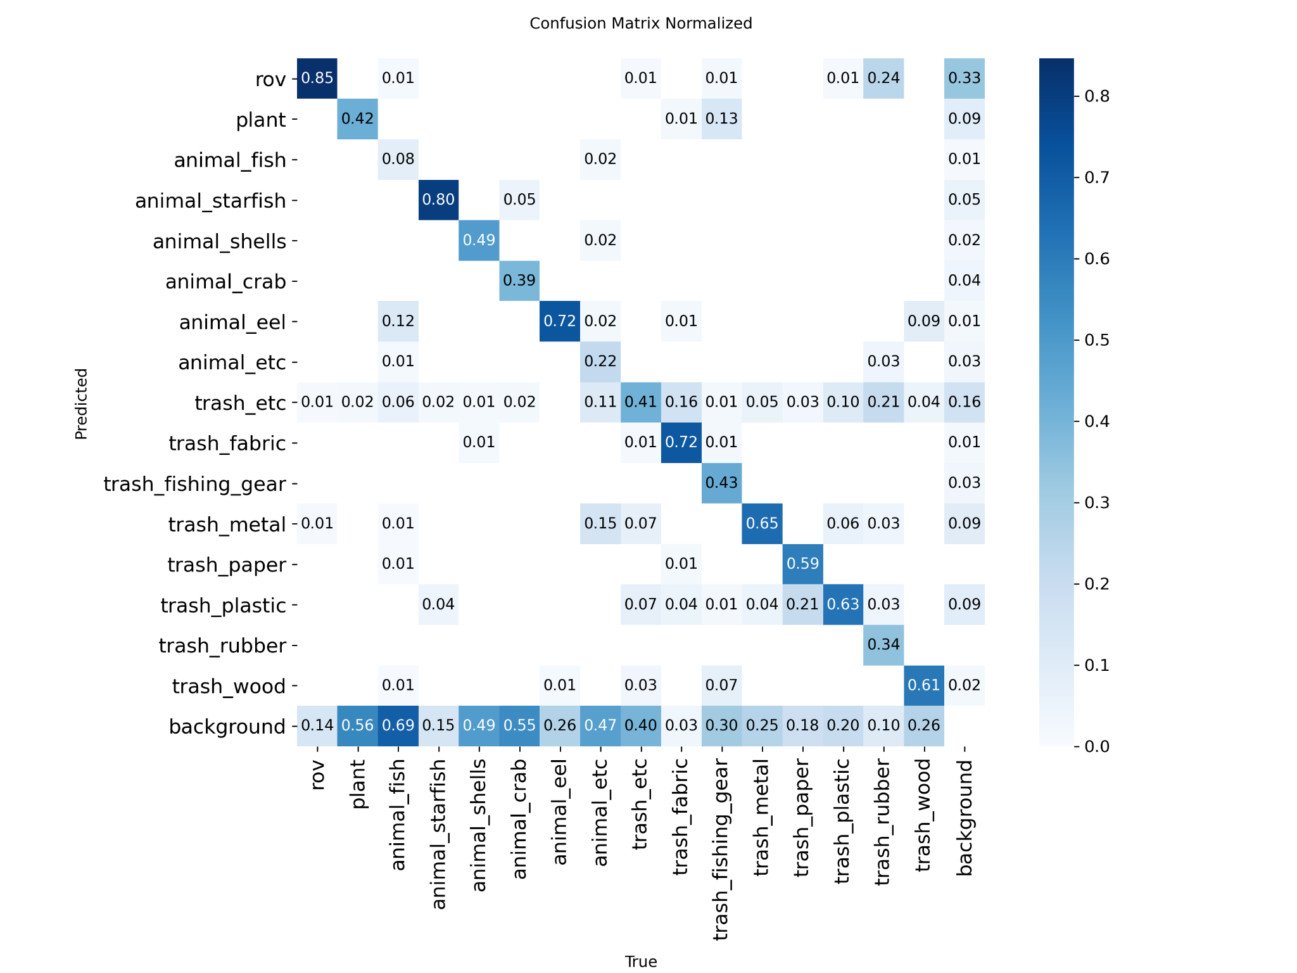
Methodology
without preprocessing original
11

Slide 8
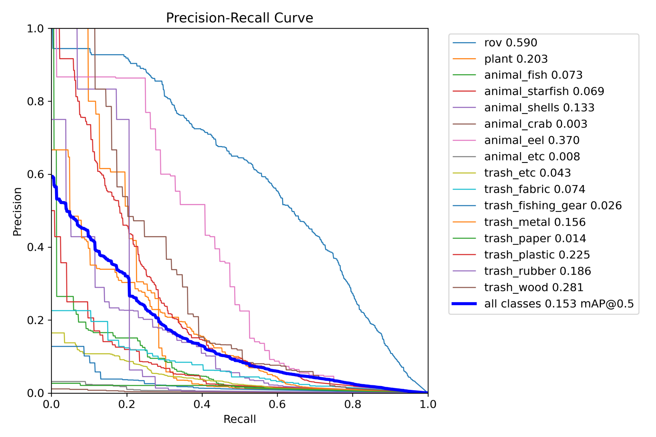
Methodology
without preprocessing grayscale
11

Slide 9
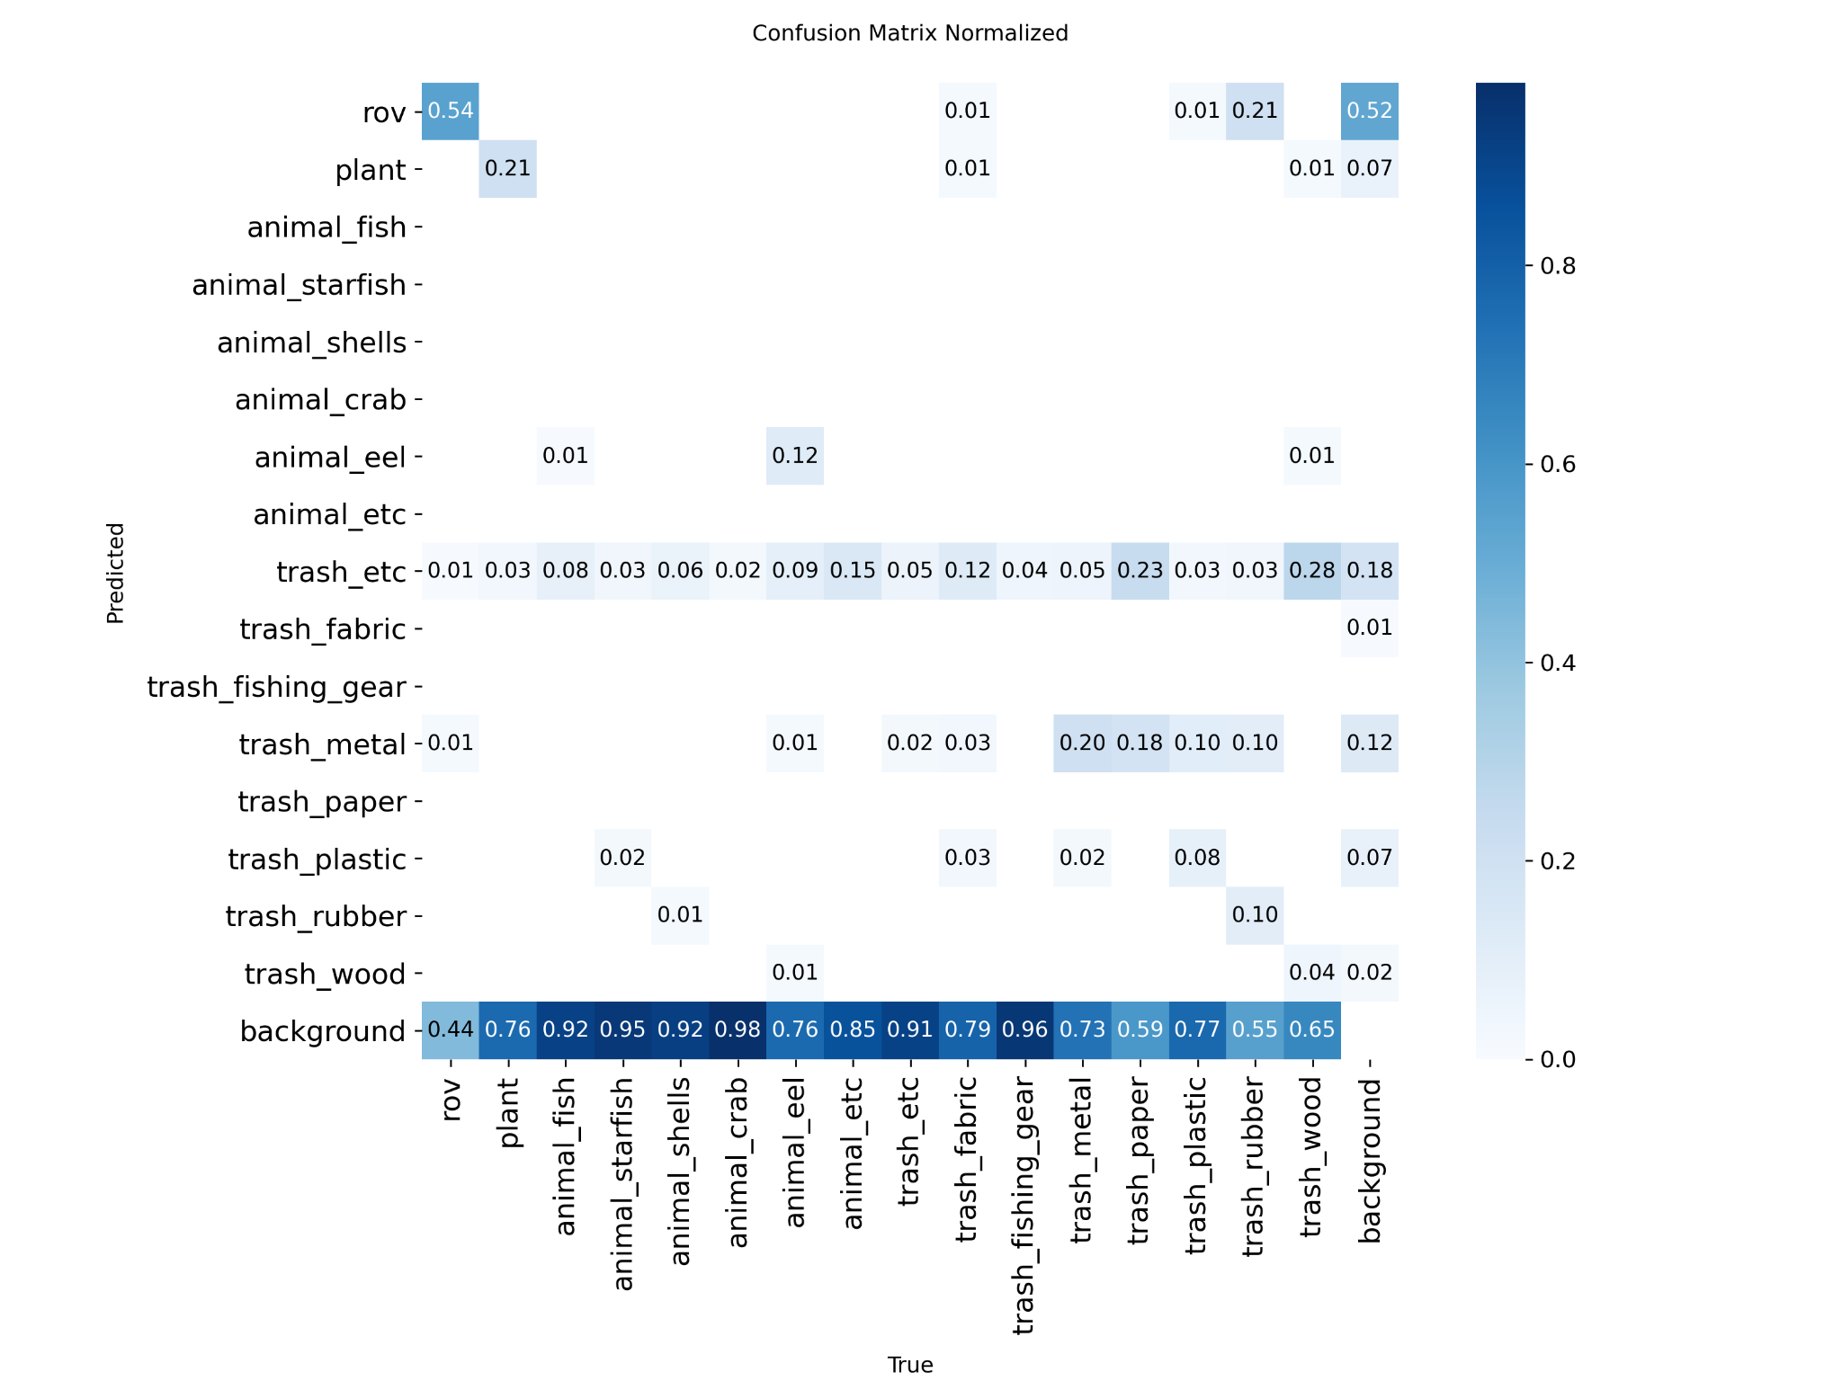
Methodology
without preprocessing grayscale
11

Slide 10
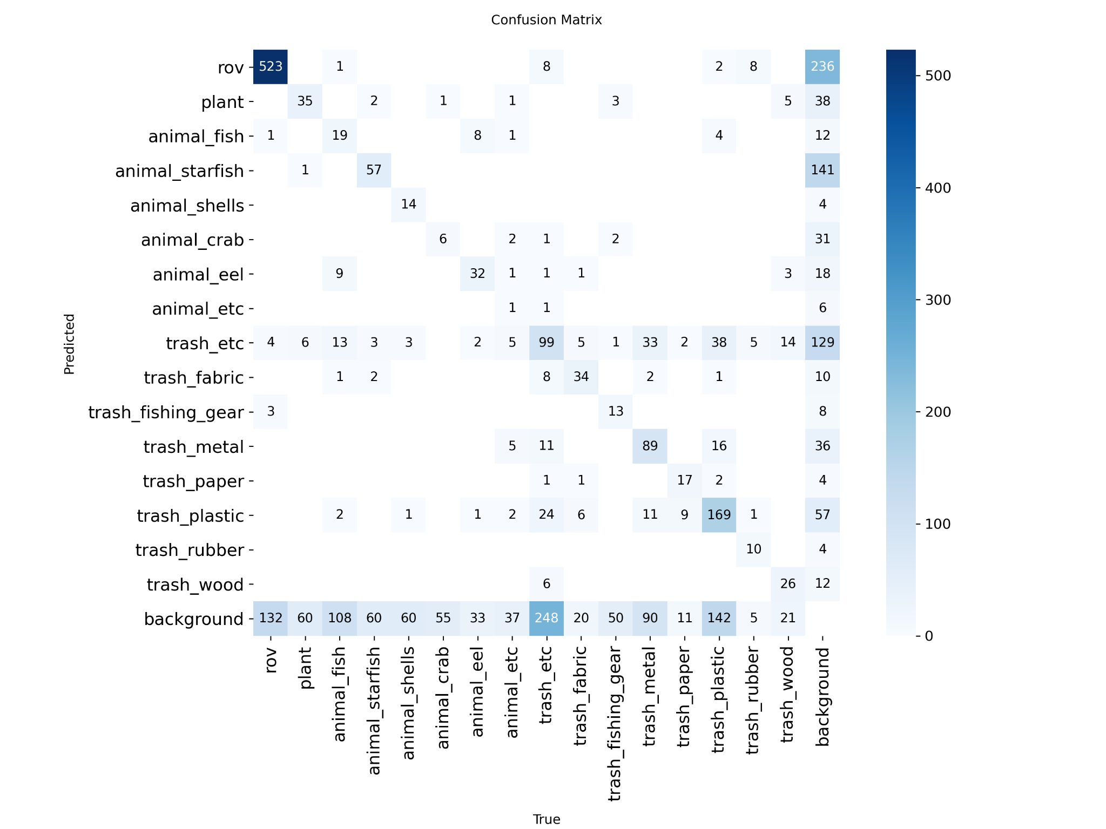
Methodology
with preprocessing blur
11

Slide 11
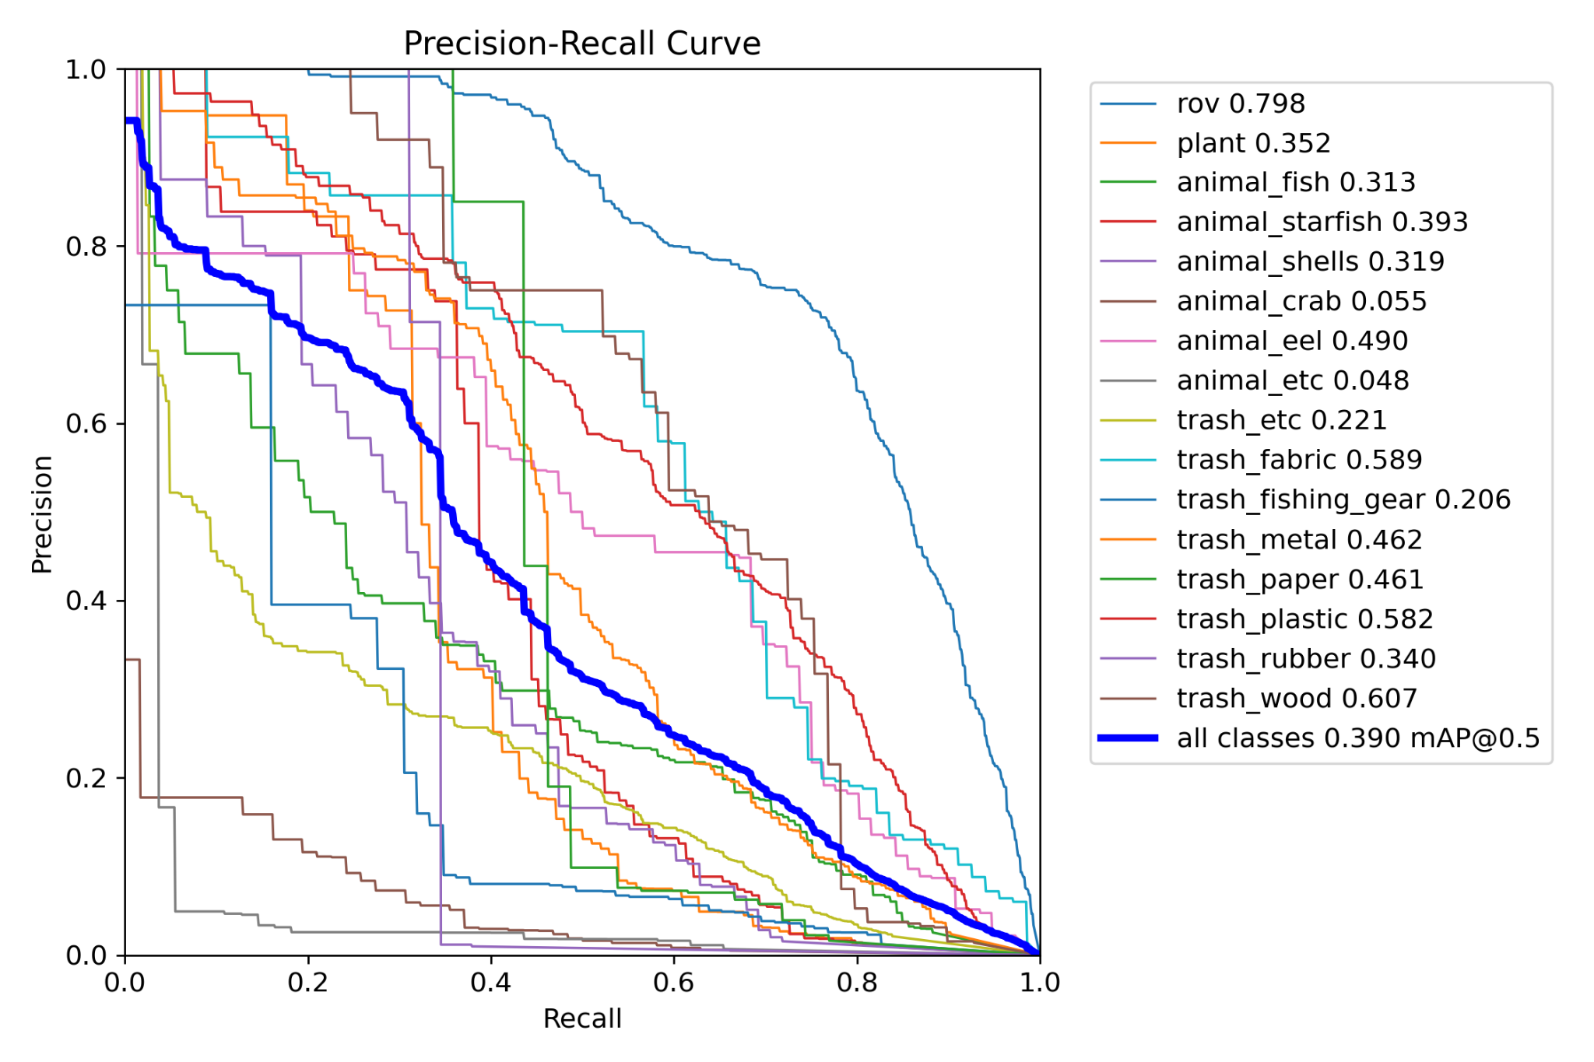
Methodology
with preprocessing blur
11

Slide 12
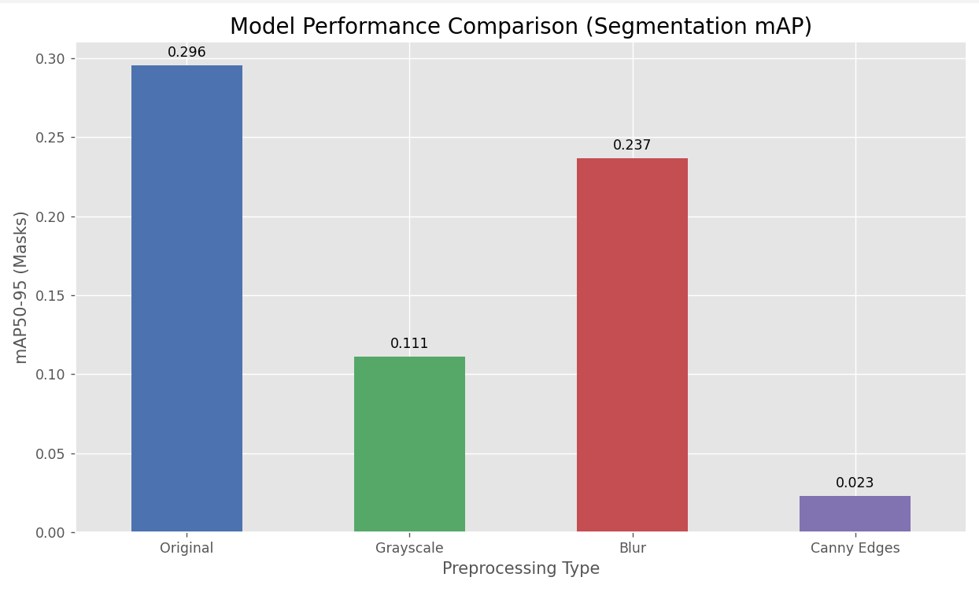
Methodology
Comparison between all the preprocessing techniques
11

Slide 13
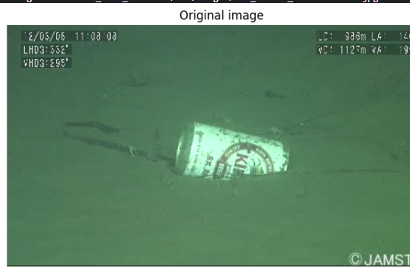
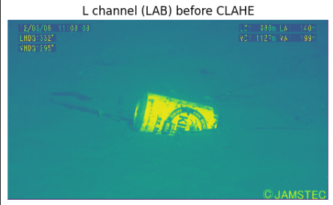
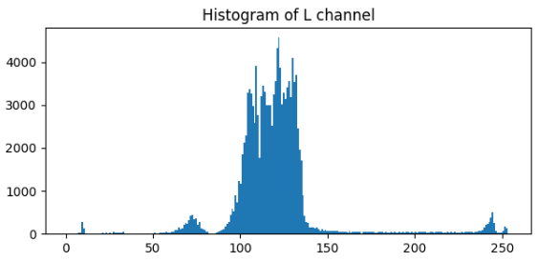
Methodology
Preprocessing used for final model training
Isolating the L (Lightness) channel shows its narrow histogram, confirming the original image's low contrast.
11
Notes:
1. Original Image
What It Is: This is our starting point—the raw, unprocessed image taken directly from the underwater camera.
What to Point Out: "Notice two main problems here. First, the image has a very strong green color cast, which is common underwater because water absorbs red light more than green and blue light. Second, the overall contrast is low, making it hard to see fine details on the seafloor and the object itself."
2. L Channel (LAB) Before CLAHE & Its Histogram
What It Is: "To fix the contrast, we first convert the image from the standard BGR color space to LAB. This is useful because LAB separates image information into L for Lightness (brightness), and 'a' and 'b' for color. This image shows only the L (Lightness) channel. It’s essentially a grayscale version of our original image."
What the Histogram Shows: "This histogram plots the distribution of brightness values in the L channel. Notice how most of the pixel values are clumped together in a narrow range in the middle. This is the mathematical confirmation of what we see with our eyes: the image has low contrast."

Slide 14
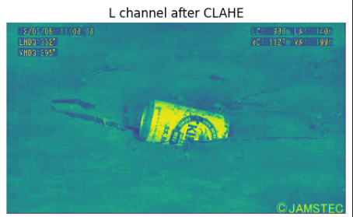
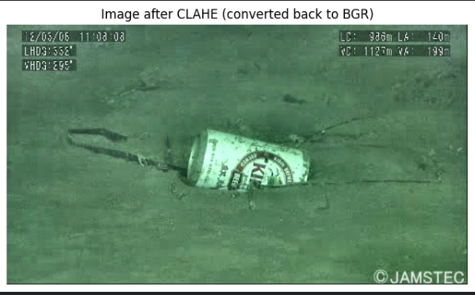
Methodology
Preprocessing used for final model training
Applying CLAHE to the L channel boosts local contrast, making details much clearer in the reconstructed image.
11

Slide 15
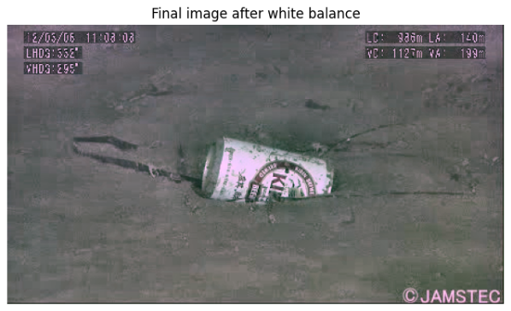
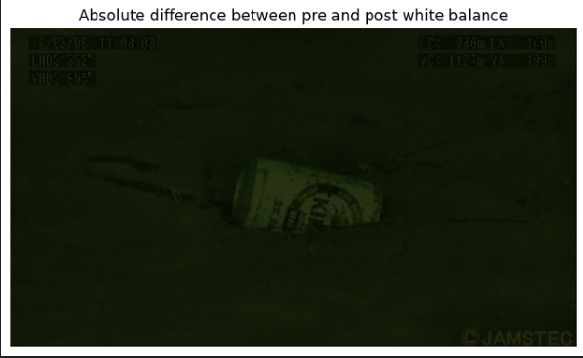
Methodology
Preprocessing used for final model training
White balance neutralizes the green tint for a natural final image, while the difference map shows exactly where color corrections were applied.
11

Slide 16
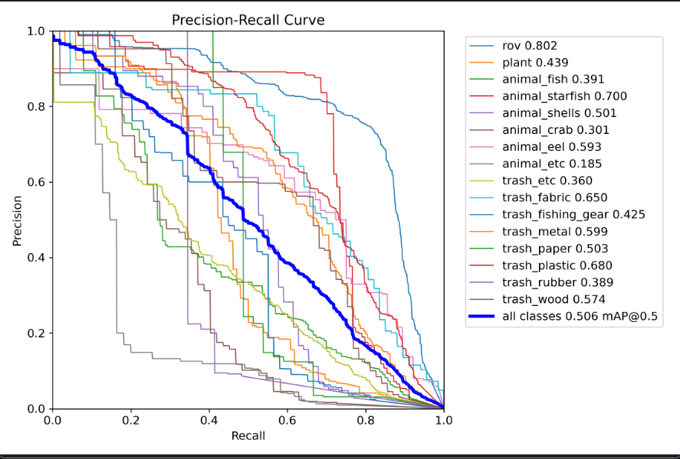
Methodology
Preprocessing used for final model training
11

Slide 17
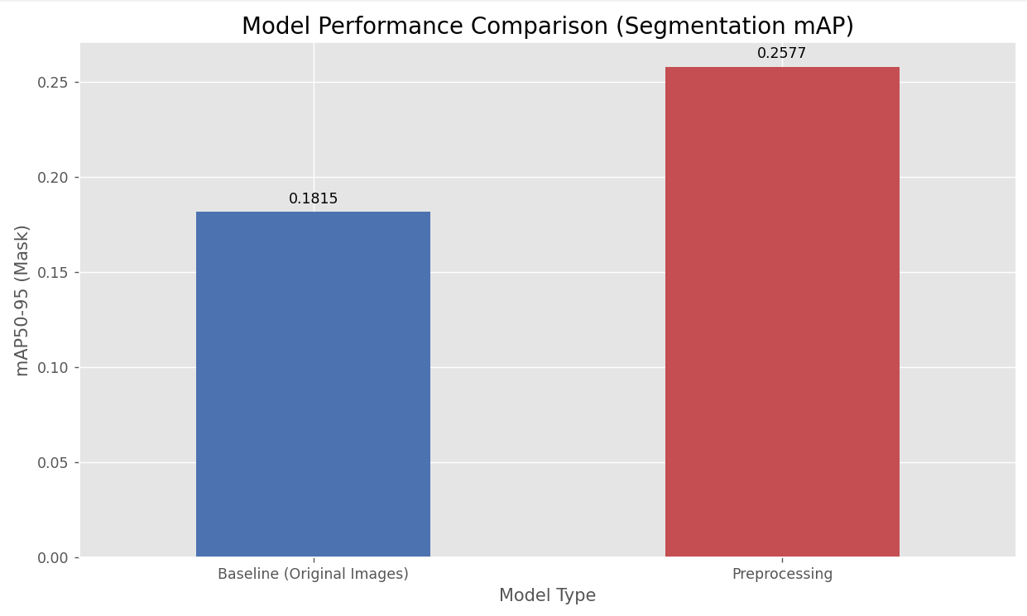
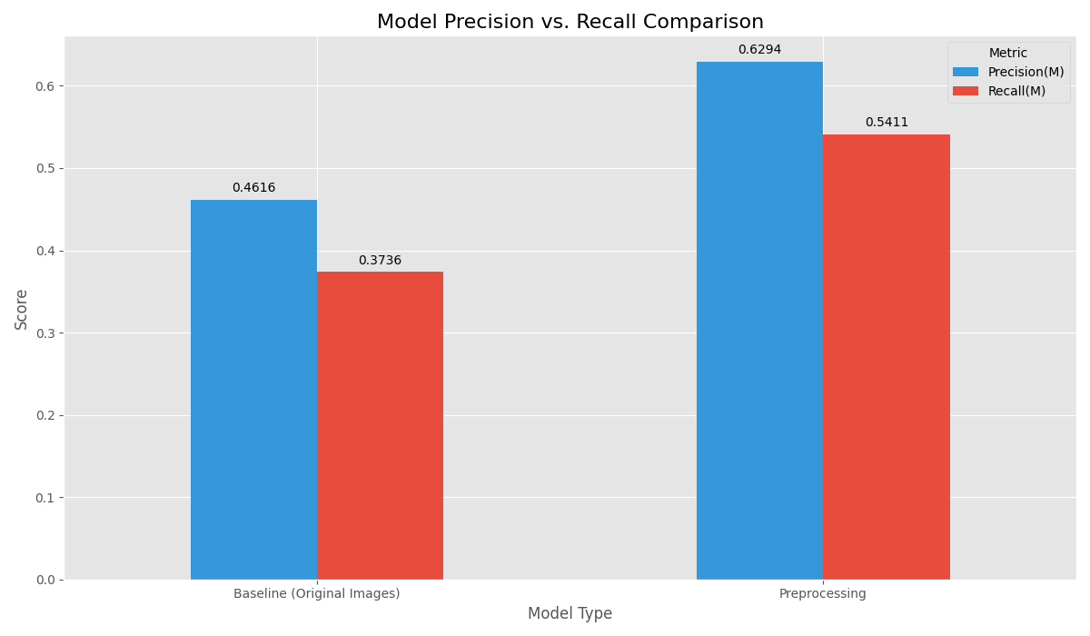
Methodology
Preprocessing used for final model training
Segmentation mAP
Precision recall
11

Slide 18
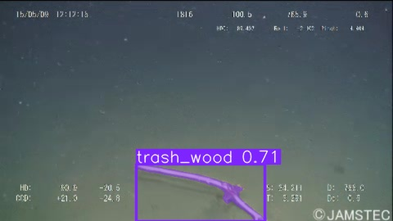
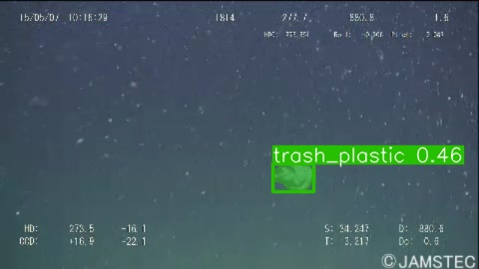
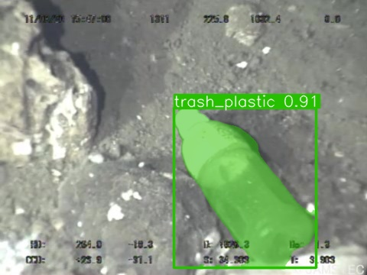
RESULTS
Identified trash_wood
Identified plastic bag
Identified plastic bottle
11

Slide 19
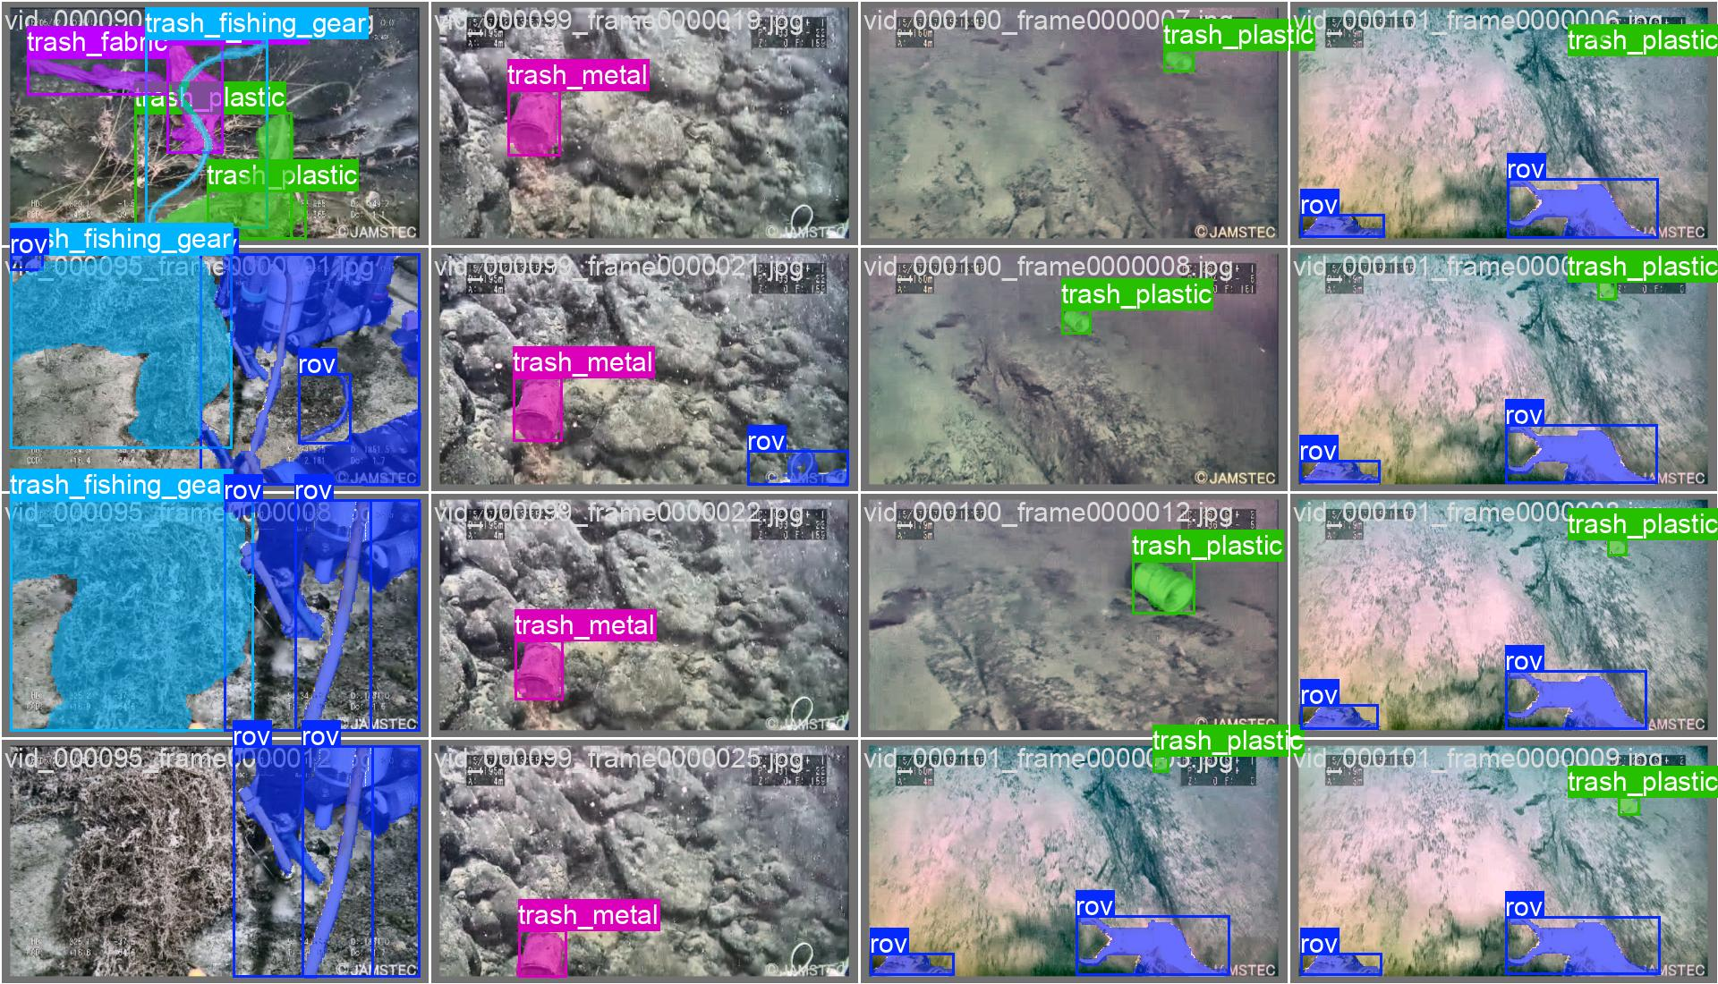
RESULTS
11

Slide 20
CONCLUSION
The preprocessing steps yielded a visually superior dataset; CLAHE yielded clearer, higher-contrast images by enhancing local details , while white balancing yielded more color-natural images by neutralizing the strong green tint.
This enhanced dataset directly yielded a more effective model. The pipeline was proven to be highly successful, boosting the crucial segmentation mAP score from 0.1815 to 0.2955
Ultimately, the combination of these preprocessing steps yielded a model with far greater accuracy and reliability. This is demonstrated by the significant gains in both precision (which rose from 0.46 to 0.63) and recall (which rose from 0.37 to 0.54) compared to the baseline.
14

Slide 21

THANK YOU

